Slide 1

106 Unsupervised Learning – Association Rules
Sunil Gorantla

Slide 2
Introduction
A method for discovering interesting relationships (associations) between variables in large datasets.
Commonly used in market basket analysis to identify products that frequently co-occur in transactions.
Example: If a customer buys bread, they are likely to buy butter.

Slide 3
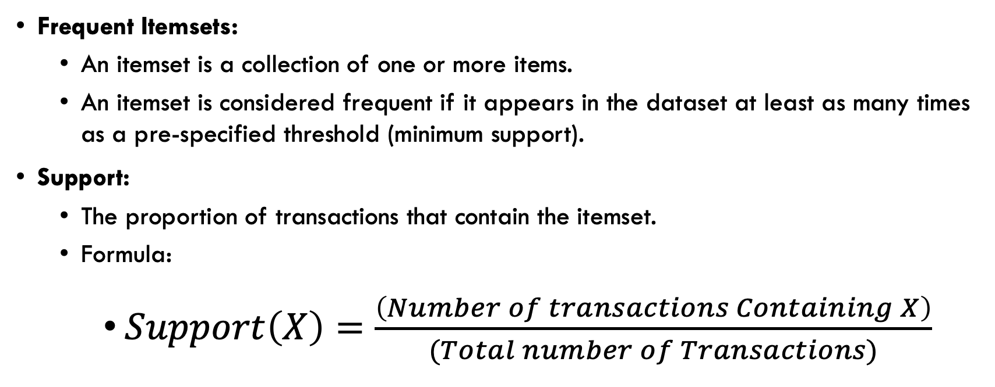
Frequency and Support
Frequent Itemsets:
An itemset is a collection of one or more items.
An itemset is considered frequent if it appears in the dataset at least as many times as a pre-specified threshold (minimum support).
Support:
The proportion of transactions that contain the itemset.
Formula:
$Support\left(X\right)=\frac{\left(Number of transactions Containing X\right)}{(Total number of Transactions)}$

Slide 4
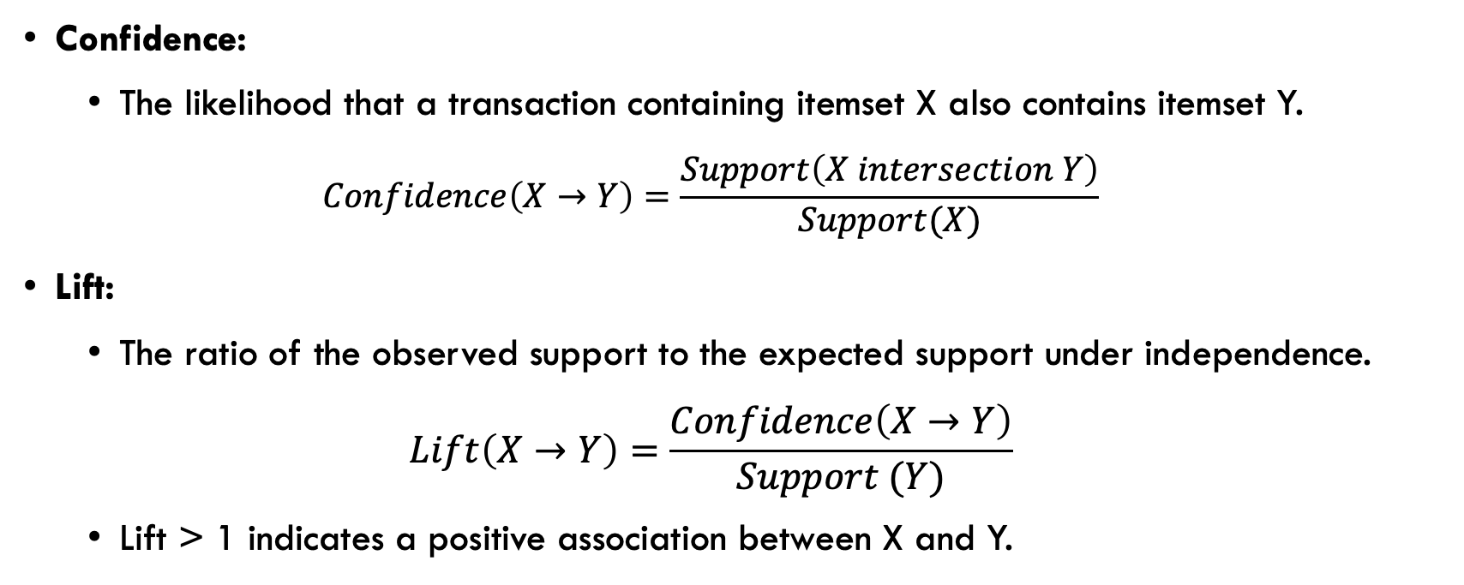
Confidence, lift
Confidence:
The likelihood that a transaction containing itemset X also contains itemset Y.
$$Confidence\left(X→Y\right)=\frac{Support\left(X intersection Y\right)}{Support(X)}$$
Lift:
The ratio of the observed support to the expected support under independence.
$$Lift\left(X→Y\right)=\frac{Confidence\left(X→Y\right)}{Support (Y)}$$
Lift > 1 indicates a positive association between X and Y.

Slide 5
Total = 100
Tomato = 100
Bread = 40
Jam = 15

Slide 6
Algorithm
Step 1: Generate candidate itemsets of length 1.
Step 2: Prune the itemsets that do not meet the minimum support threshold.
Step 3: Generate candidate itemsets of length 2 from the frequent itemsets of length 1.
Step 4: Repeat until no more frequent itemsets can be generated.
Step 5: Generate association rules from the frequent itemsets.

Slide 7
ECLAT
ECLAT (Equivalence Class Clustering and bottom-up Lattice Traversal) is an efficient algorithm for finding frequent itemsets.
Unlike Apriori, which uses horizontal data layout (itemsets), ECLAT uses vertical data layout (transaction IDs).
Developed as an alternative to Apriori to handle large datasets more efficiently.

Slide 8
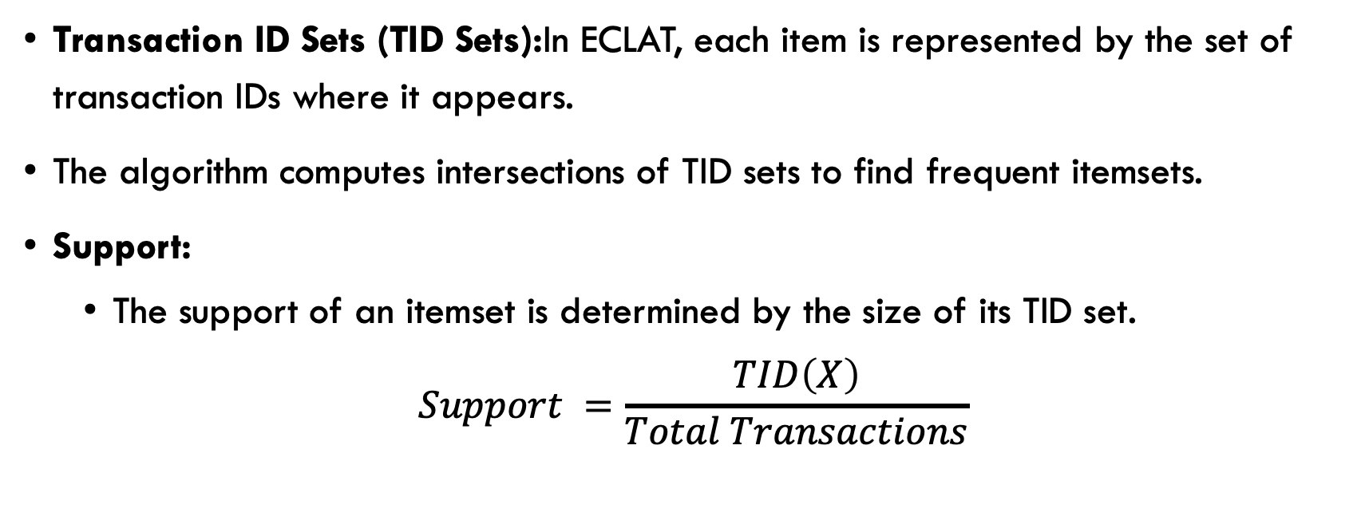
TID and Support
Transaction ID Sets (TID Sets):In ECLAT, each item is represented by the set of transaction IDs where it appears.
The algorithm computes intersections of TID sets to find frequent itemsets.
Support:
The support of an itemset is determined by the size of its TID set.
$$Support =\frac{TID\left(X\right)}{Total Transactions}$$

Slide 9
Algorithm
Step 1: Convert the dataset into a vertical format where each item is associated with a TID set.
Step 2: Calculate the support for individual items by counting the number of transactions in their TID sets.
Step 3: Generate larger itemsets by intersecting TID sets of smaller itemsets (e.g., pairwise intersections for 2-itemsets).
Step 4: Prune itemsets that do not meet the minimum support threshold.
Step 5: Continue this process until no larger frequent itemsets can be generated.

Slide 10
Example
Transaction ID | Items Purchased
T1 | {Bread, Milk, Butter}
T2 | {Bread, Milk}
T3 | {Milk, Butter}
T4 | {Bread, Butter}
T5 | {Bread, Milk, Butter}

Slide 11
Data Layout
Apriori
T1: {Bread, Milk, Butter}
T2: {Bread, Milk}
T3: {Milk, Butter}
T4: {Bread, Butter}
T5: {Bread, Milk, Butter}
ECLAT
Bread: {T1, T2, T4, T5}
Milk: {T1, T2, T3, T5}
Butter: {T1, T3, T4, T5}

Slide 12
Frequent 1-Itemsets Generation
Apriori
{Bread}: 4 transactions
{Milk}: 4 transactions
{Butter}: 4 transactions
ECLAT
Bread: {T1, T2, T4, T5} (4 transactions)
Milk: {T1, T2, T3, T5} (4 transactions)
Butter: {T1, T3, T4, T5} (4 transactions)

Slide 13
Frequent 2-Itemsets Generation
Apriori
{Bread, Milk}: 3 transactions
{Bread, Butter}: 3 transactions
{Milk, Butter}: 3 transactions
ECLAT
{Bread, Milk}: {T1, T2, T5} (3 transactions)
{Bread, Butter}: {T1, T4, T5} (3 transactions)
{Milk, Butter}: {T1, T3, T5} (3 transactions)

